Slide 1
Reporting on Sustainability
A stocktake of EU Institutions and Agencies
21 November 2019
Eva Lindström
Member of the European Court of Auditors

Slide 2
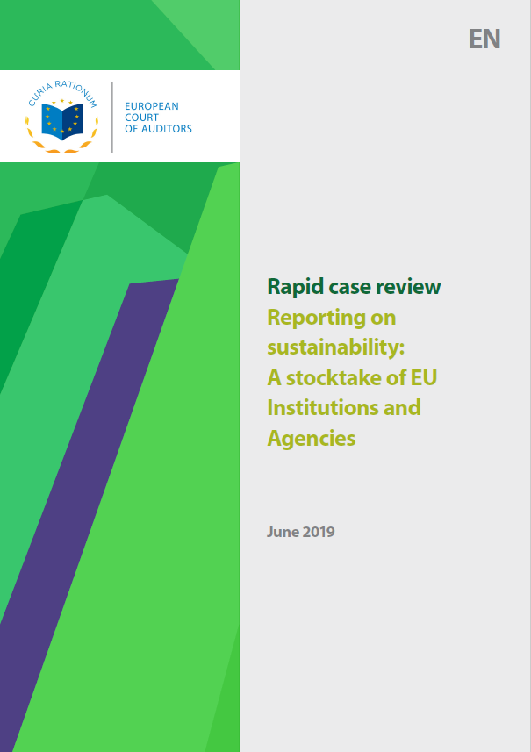
Rapid Case Review

Slide 3

Sustainability Reporting

Slide 4

Starting Point
Agenda 2030
EU Directive
The EU and its Member States are fully committed to the SDGs
EU law requires certain large companies to report on sustainability

Slide 5
Main review question
What is the status of reporting on
the achievement of the SDGs at EU level
&
sustainability reporting by individual
EU institutions and agencies?

Slide 6



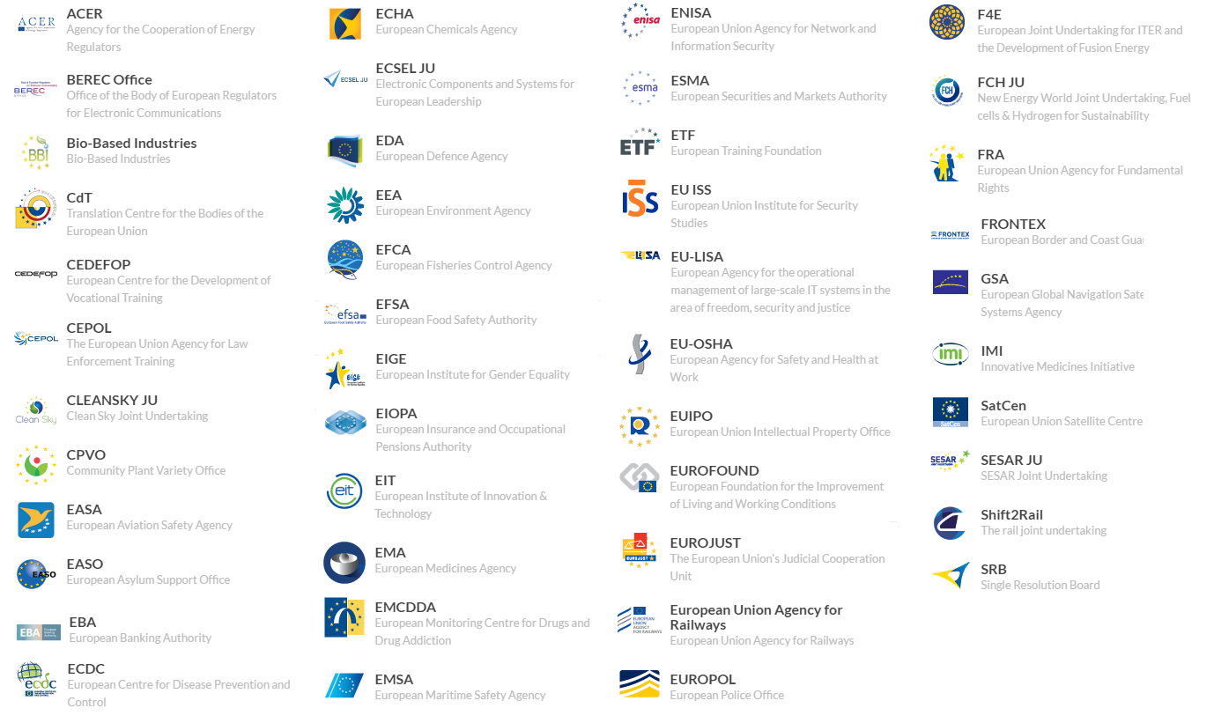









Approach
12 EU institutions
41 EU agencies

Slide 7



What the Commission has done…
…or not done
Reflection Paper
Performance Reporting
Eurostat report

Slide 8

Individual reporting
by EU institutions and agencies
Covered: 12 institutions and 41 agencies
Two EU bodies publish sustainability reports
  European Investment Bank (EIB)
  European Intellectual Property Office (EUIPO)
Others:
  Information incomplete and piecemeal
  Focus on running of organisation rather than how sustainability integrated in strategy & activities
Notes:
We also looked at what individual EU Institutions and agencies are doing on sustainability reporting (click).
Only two European bodies (click) – the European Investment Bank and the EU Intellectual Property Office – have so far published sustainability reports.
(click) Other Institutions and agencies publish incomplete and piecemeal information. Reporting is mainly on how the running of an organisation impacts on sustainability but not how sustainability has been integrated into strategy or policy. This risks that important issues are not covered.
There is a two-way interaction: on the one side, the impact an organisation has on climate change and on the other hand, the impact climate change has on the business.
So to conclude: No reporting from the Commission and out of 53 bodies, 2 do sustainability reporting.
So you could ask why this is the state of affairs? As said before reporting is just the end of a process. We found that the prerequisites are not in place yet. For meaningful reporting to take place there needs to be a strategy, an integration of SDGs into the budget, reporting - and you need to secure that stakeholders can trust this information.

Slide 9

Four major challenges
Overall Strategy
Budget and performance
Reporting
Audit

